Slide 1
Chapter 13
Business Intelligence and Data Warehouses

Slide 2
Learning Objectives
After completing this chapter, you will be able to:
Describe the role of business intelligence in providing comprehensive business decision support
Describe the architecture, reporting styles, evolution, and benefits of business intelligence
Differentiate between operational data and decision support data
Identify the purpose, characteristics, and components of a data warehouse
Develop star and snowflake schemas for decision-making purposes
Describe the characteristics and capabilities of online analytical processing (OLAP)
Describe the role and functions of data analytics and data mining
Explain how SQL analytic functions are used to support data analytics
Define data visualization and explain how it supports business intelligence

Slide 3
The Need for Data Analysis
Organizations tend to grow and prosper as they gain a better understanding of their environment
Evaluate through tracking daily transactions and analyzing company data
Organizations are always looking for a competitive advantage
Product development, market positioning, sales promotions, and customer service
Companies and software vendors addressed these multilevel decision support needs by creating autonomous applications for particular groups of users
This more comprehensive and integrated decision support framework within organizations became known as business intelligence

Slide 4
Business Intelligence (1 of 2)
Comprehensive, cohesive, integrated set of tools and processes
Captures, collects, integrates, stores, and analyzes data
Generates and presents information to support business decision making
Allows transformation
Data into information
Information into knowledge
Knowledge into wisdom

Slide 5
Business Intelligence (2 of 2)
Concepts, practices, tools and techniques to help business
Understand core capabilities
Provide snapshots of the company situation
Identify key opportunities to create a competitive advantage
Provides a framework
Collecting and storing operational data and aggregating it into decision support data
Analyzing decision support data and presenting generated information to end users to support business decisions
Making business decisions which generate more data
Monitoring results to evaluate outcomes and predicting future outcomes with a high degree of accuracy

Slide 6
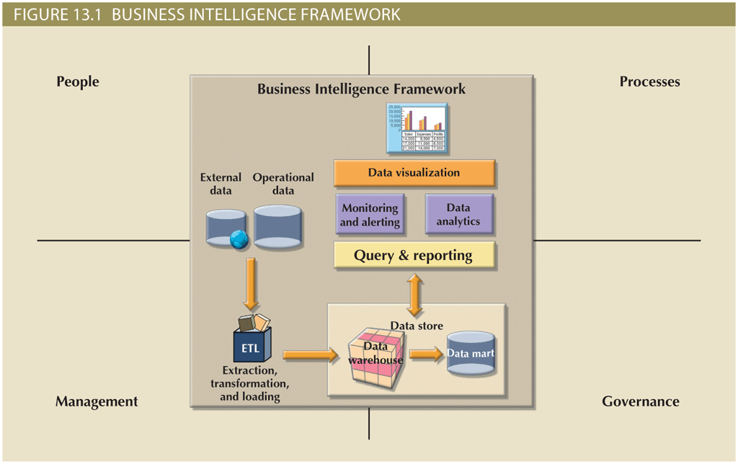
Business Intelligence Architecture (1 of 3)

Slide 7
Business Intelligence Architecture (2 of 3)
Table 13.2 Basic BI Architectural Components
Component | Description
ETL tools | Data extraction, transformation, and loading (ETL ) tools collect, filter, integrate, and aggregate internal and external data to be saved into a data store optimized for decision support.
Data store | The data store is optimized for decision support and is generally represented by a data warehouse or a data mart. The data is stored in structures that are optimized for data analysis and query speed.
Query and reporting | This component performs data selection and retrieval, and it is used by the data analyst to create queries that access the database and create the required reports.
Data visualization | This component presents data to the end user in a variety of meaningful and innovative ways. This tool helps the end user select the most appropriate presentation format, such as summary reports, maps, pie or bar graphs, mixed graphs, and static or interactive dashboards.
Data monitoring and alerting | This component allows real-time monitoring of business activities. The BI system will present concise information in a single integrated view. This integrated view could include specific metrics about the system performance or activities, such as number of orders placed in the last four hours, number of customer complaints by product by month, and total revenue by region. Alerts can be placed on a given metric; once the value of a metric goes below or above a certain baseline, the system will perform a given action, such as emailing shop floor managers, presenting visual alerts, or starting an application.
Data analytics | This component performs data analysis and data-mining tasks using the data in the data store. This tool advises the user as to which data analysis tool to select and how to build a reliable business data model. Business models are generated by special algorithms that identify and enhance the understanding of business situations and problems.

Slide 8
Business Intelligence Architecture (3 of 3)
Practices to manage data
Master data management (MDM): collection of concepts, techniques, and processes for identification, definition, and management of data elements
Governance: method of government for controlling business health and for consistent decision making
Key performance indicators (KPI): numeric or scale-based measurements that assess company’s effectiveness in reaching its goals
General
Finance
Human resources
Education
Modern BI reporting styles
Advanced reporting
Monitoring and alerting
Advanced data analytics

Slide 9
Business Intelligence Benefits
Improved decision making is the main goal of BI, but BI provides other benefits
Integrating architecture
Common user interface for data reporting and analysis
Common data repository fosters single version of company data
Improved organizational performance
Achieving all these benefits takes a lot of human, financial, technological resources, and time
BI benefits are not achieved overnight; are the result of a focused company-wide effort that could take a long time

Slide 10
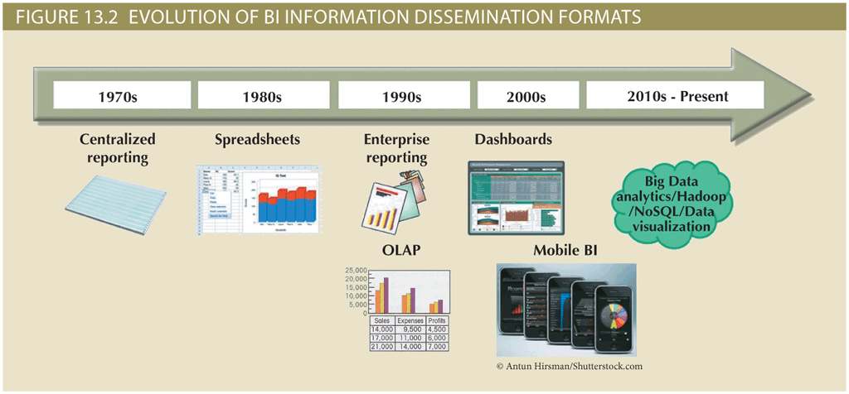
Business Intelligence Evolution (1 of 2)

Slide 11
Business Intelligence Evolution (2 of 2)
Decision support system (DSS) is an arrangement of computerized tools used to assist managerial decision making
Typically has a much narrower focus and reach than a BI solution
BI information technology has evolved from centralized reporting styles to the current, mobile BI and Big Data analytics style in the span of just a few years
The rate of technological change is not slowing down; technology advancements are accelerating the adoption of BI to new levels

Slide 12
Business Intelligence Technology Trends
Several technological advances are driving the growth of business intelligence technologies
Data storage improvements
Business intelligence appliances
Business intelligence as a service
Big Data analytics
Personal analytics

Slide 13
Decision Support Data
Although BI is used at the strategic and tactical managerial levels within organizations, its effectiveness depends on the quality of data gathered at the operational level
Operational data is seldom well suited to decision support tasks

Slide 14
Operational Data versus Decision Support Data (1 of 3)
Operational data and decision support data serve different purposes
Operational data is useful for capturing daily business transactions
Decision support data gives tactical and strategic business meaning to the operational data
Decision support data differs from operational data in three main areas
Time span
Granularity (level of aggregation)
Dimensionality

Slide 15
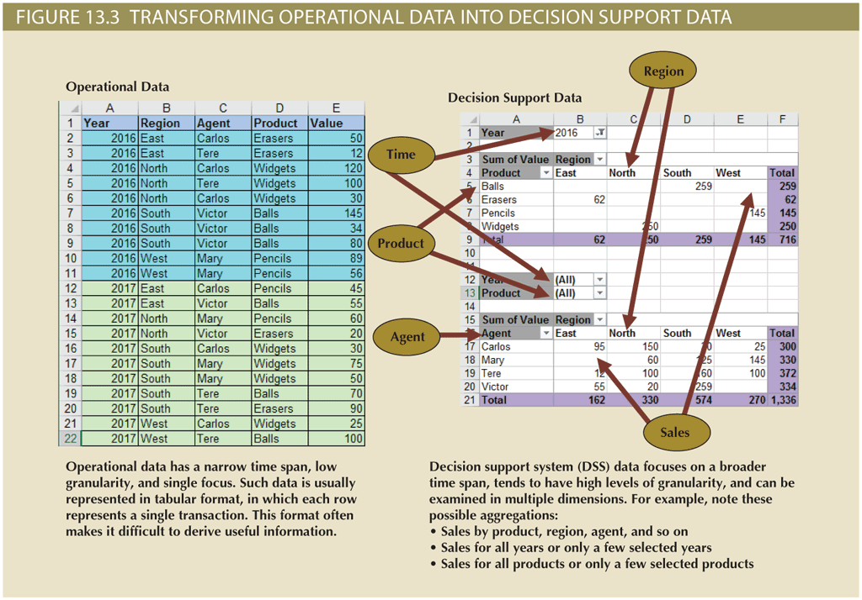
Operational Data versus Decision Support Data (2 of 3)

Slide 16
Operational Data versus Decision Support Data (3 of 3)
Table 13.5 Contrasting Operational and Decision Support Data Characteristics
Characteristic | Operational Data | Decision Support Data
Data currency | Current operations Real-time data | Historic data Snapshot of company data Time component (week/month/year)
Granularity | Atomic-detailed data | Summarized data
Summarization level | Low; some aggregate yields | High; many aggregation levels
Data model | Highly normalized Mostly relational DBMSs | Non-normalized Complex structures Some relational, but mostly multidimensional DBMSs
Transaction type | Mostly updates | Mostly query
Transaction volumes | High-update volumes | Periodic loads and summary calculations
Transaction speed | Updates are critical | Retrievals are critical
Query activity | Low to medium | High
Query scope | Narrow range | Broad range
Query complexity | Simple to medium | Very complex
Data volumes | Hundreds of gigabytes | Terabytes to petabytes

Slide 17
Decision Support Database Requirements
Database schema
Must support complex, non-normalized data representations
Data must be aggregated and summarized
Queries must be able to extract multidimensional time slices
Data extraction and filtering
Allow batch and scheduled data extraction
Support different data sources and check for inconsistent data or data validation rules
Encourage advanced integration, aggregation, and classification
Database size
Very large databases (VLDBs)
Advanced storage technologies
Multiple-processor technologies

Slide 18
The Data Warehouse (1 of 3)
Collection of data
Provides support for decision making
Components
Integrated
Subject-oriented
Time-variant
Nonvolatile

Slide 19
The Data Warehouse (2 of 3)
Table 13.8 Characteristics of Data Warehouse Data and Operational Database Data
Characteristic | Operational Database Data | Data Warehouse Data
Integrated | Similar data can have different representations or meanings. For example, Social Security numbers may be stored as ###-##-#### or as #########, and a given condition may be labeled as T/F or 0/1 or Y/N. A sales value may be shown in thousands or in millions. | Provide a unified view of all data elements with a common definition and representation for all business units.
Subject-oriented | Data is stored with a functional, or process, orientation. For example, data may be stored for invoices, payments, and credit amounts. | Data is stored with a subject orientation that facilitates multiple views of the data and decision making. For example, sales may be recorded by product, division, manager, or region.
Time-variant | Data is recorded as current transactions. For example, the sales data may be the sale of a product on a given date, such as $342.78 on 12-MAY-2016. | Data is recorded with a historical perspective in mind. Therefore, a time dimension is added to facilitate data analysis and various time comparisons.
Nonvolatile | Data updates are frequent and common. For example, an inventory amount changes with each sale. Therefore, the data environment is fluid. | Data cannot be changed. Data is added only periodically from historical systems. Once the data is properly stored, no changes are allowed. Therefore, the data environment is relatively static.

Slide 20
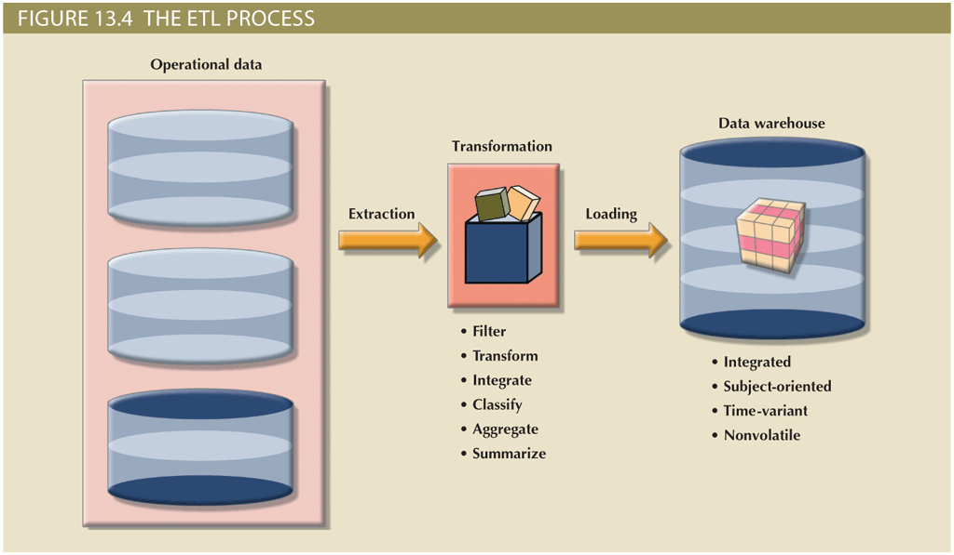
The Data Warehouse (3 of 3)

Slide 21
Data Marts
Small, single-subject data warehouse subset
Provides decision support to a small group of people
Benefits over data warehouses
Lower cost and shorter implementation time
Technologically advanced
Inevitable “people issues”

Slide 22
Twelve Rules That Define a Data Warehouse
Table 13.9 | Twelve Rules for a Data Warehouse
Rule No. | Description
1 | The data warehouse and operational environments are separated.
2 | The data warehouse data is integrated.
3 | The data warehouse contains historical data over a long time.
4 | The data warehouse data is snapshot data captured at a given point in time.
5 | The data warehouse data is subject oriented.
6 | The data warehouse data is mainly read-only with periodic batch updates from operational data. No online updates are allowed.
7 | The data warehouse development life cycle differs from classical systems development. Data warehouse development is data-driven; the classical approach is process-driven.
8 | The data warehouse contains data with several levels of detail: current detail data, old detail data, lightly summarized data, and highly summarized data.
9 | The data warehouse environment is characterized by read-only transactions to very large data sets. The operational environment is characterized by numerous update transactions to a few data entities at a time.
10 | The data warehouse environment has a system that traces data sources, transformations, and storage.
11 | The data warehouse’s metadata is a critical component of this environment. The metadata identifies and defines all data elements. The metadata provides the source, transformation, integration, storage, usage, relationships, and history of each data element.
12 | The data warehouse contains a chargeback mechanism for resource usage that enforces optimal use of the data by end users.

Slide 23
Star Schemas (1 of 5)
Data-modeling technique
Maps multidimensional decision support data into a relational database
Creates the near equivalent of multidimensional database schema from existing relational database
Yields an easily implemented model for multidimensional data analysis

Slide 24
Star Schemas (2 of 5)
Basic star schema components
Facts: numeric values that represent a specific business aspect
Dimensions: qualifying characteristics that provide additional perspectives to a given fact
Attributes: used to search, filter, and classify facts
Slice and dice: ability to focus on slices of the data cube for more detailed analysis
Attribute hierarchies: provide a top-down data organization
Aggregation and drill-down/roll-up data analysis

Slide 25
Star Schemas (3 of 5)
Star schema representation
Facts and dimensions represented by physical tables in data warehouse database
Many-to-one (M:1) relationship between fact table and each dimension table
Fact and dimension tables
Related by foreign keys
Subject to primary and foreign key constraints
Primary key of a fact table
Composite primary key because the fact table is related to many dimension tables
Always formed by combining the foreign keys pointing to the related dimension tables

Slide 26
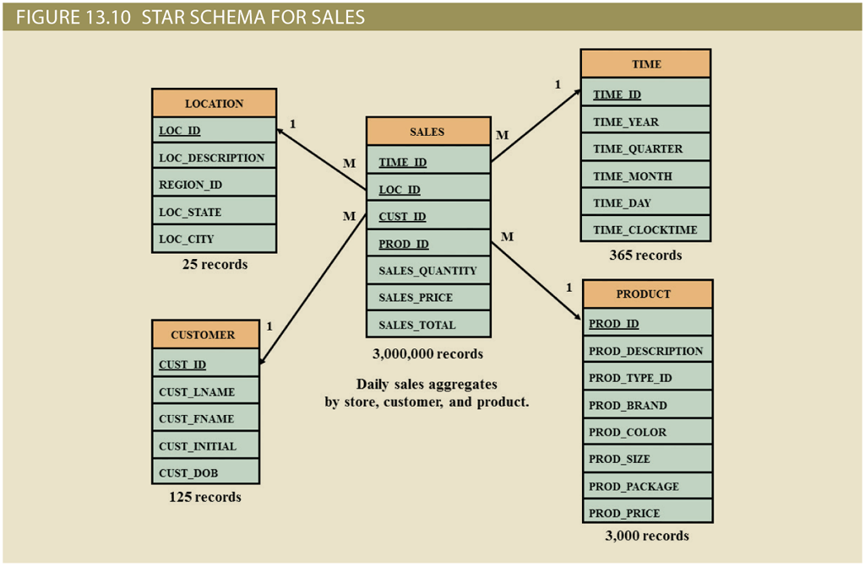
Star Schemas (4 of 5)

Slide 27
Star Schemas (5 of 5)
Performance-improving techniques for the star schema
Normalizing dimensional tables
Snowflake schema: dimension tables can have their own dimension tables
Maintaining multiple fact tables to represent different aggregation levels
Save processor cycles at run time, thereby speeding up data analysis
Denormalizing fact tables
Improves data access performance and saves data storage space
Partitioning and replicating tables
Partitioning: splits tables into subsets of rows or columns and places them close to the client computer
Replication: makes copy of table and places it in a different location
Periodicity: provides information about the time span of the data stored in the table

Slide 28
Online Analytical Processing (OLAP)
Online analytical processing (OLAP) is a BI style whose systems share three main characteristics
Multidimensional data analysis techniques
Advanced database support
Easy-to-use end-user interfaces

Slide 29
Multidimensional Data Analysis Techniques
Data are processed and viewed as part of a multidimensional structure
Particularly attractive to business decision makers who tend to view business data as being related to other business data
Augmented advanced functions
Data presentation
Data aggregation, consolidation, and classification
Computational
Data-modeling

Slide 30
Advanced Database Support
OLAP tools must have the following features to deliver efficient decision support:
Access to many different kinds of DBMSs, flat files, and internal and external data sources
Access to aggregated data warehouse data and operational database detail data
Advanced data navigation features
Rapid and consistent query response times
Ability to map end-user requests
Support for very large databases

Slide 31
Easy-to-Use End-User Interface
When proper implementation leads to simple navigation and accelerated decision making or data analysis
Advanced OLAP features are more useful when access is kept simple
Many interface features are borrowed from previous generations of data analysis tools

Slide 32
OLAP Architecture (1 of 2)
Designed to meet ease-of-use requirements while keeping the system flexible
Main architectural components
Graphical user interface (GUI)
Analytical processing logic
Data-processing logic

Slide 33
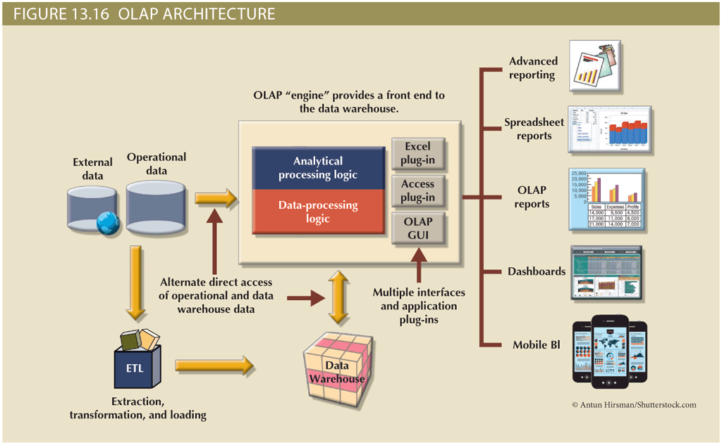
OLAP Architecture (2 of 2)

Slide 34
Relational OLAP
Relational online analytical processing (ROLAP)
Provides OLAP functionality using relational databases and familiar relational tools to store and analyze multidimensional data
Extensions added to traditional RDBMS technology
Multidimensional data schema support within the RDBMS
Data access language and query performance optimized for multidimensional data
Support for very large databases (VLDBs)

Slide 35
Multidimensional OLAP
Multidimensional online analytical processing (MOLAP)
Extends OLAP functionality to multidimensional database management systems (MDBMSs)
MDBMS uses proprietary techniques store data in matrix-like n-dimensional arrays
End users visualize stored data as a three dimensional data cube
Grow to n number dimensions, thus becoming hypercubes
Held in memory in a cube cache to speed access
Sparsity: measures density of data held in the data cube

Slide 36
Relational versus Multidimensional OLAP
Table 13.12 Relational vs. Multidimensional OLAP
Characteristic | ROLAP | MOLAP
Schema | Uses star schema Additional dimensions can be added dynamically | Uses data cubes Multidimensional arrays, row stores, column stores Additional dimensions require re-creation of the data cube
Database size | Medium to large | Large
Architecture | Client/server Standards-based | Client/server Open or proprietary, depending on vendor
Access | Supports ad hoc requests Unlimited dimensions | Limited to predefined dimensions Proprietary access languages
Speed | Good with small data sets; average for medium-sized to large data sets | Faster for large data sets with predefined dimensions

Slide 37
Data Analytics (1 of 4)
Subset of business intelligence (BI) functionality that encompasses a wide range of mathematical, statistical, and modeling techniques with the purpose of extracting knowledge from data
Explanatory analytics: focuses on discovering and explaining data characteristics and relationships based on existing data
Predictive analytics: focuses on predicting future data outcomes with a high degree of accuracy
Data mining focuses on the discovery and explanation stages of knowledge acquisition
Analyzing massive amounts of data to uncover hidden trends, patterns, and relationships; to form computer models to simulate and explain the findings; and to use such models to support business decision making

Slide 38
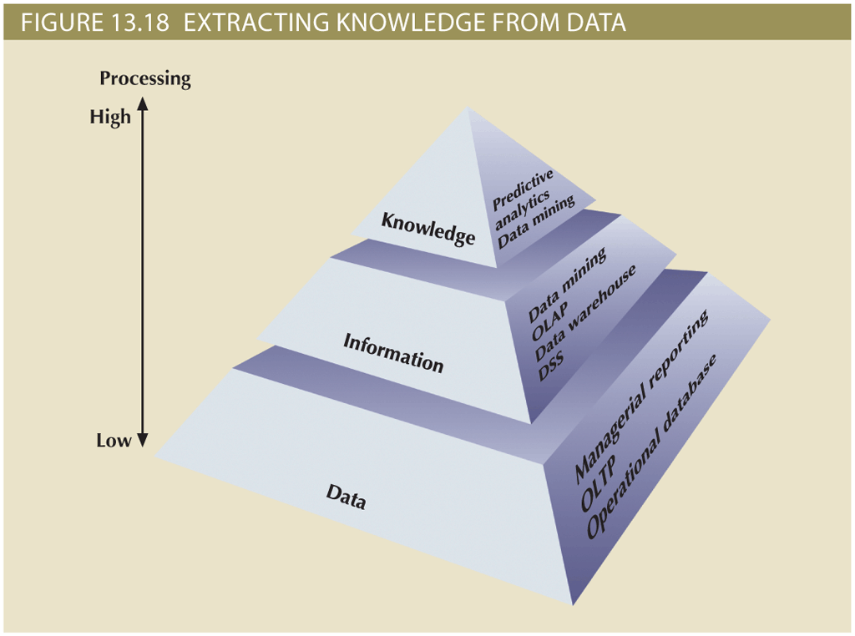
Data Analytics (2 of 4)

Slide 39
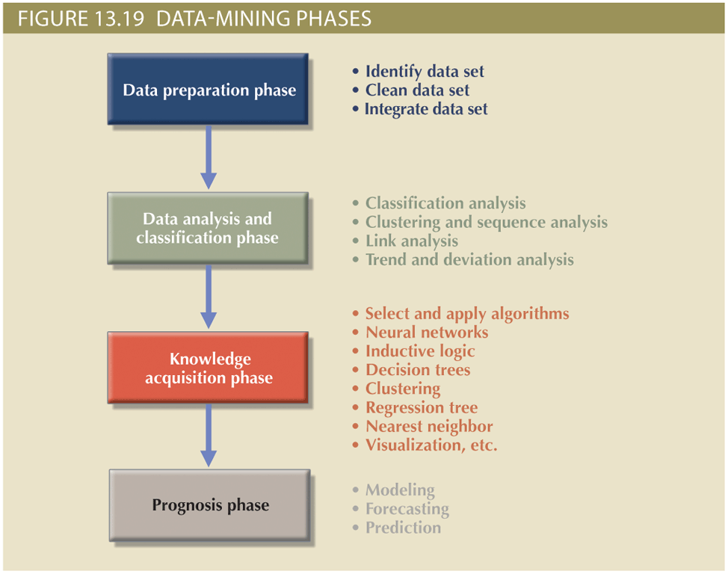
Data Analytics (3 of 4)

Slide 40
Data Analytics (4 of 4)
Predictive analytics focuses on creating actionable models to predict future behaviors and events
Employs mathematical and statistical algorithms, neural networks, artificial intelligence, and other advanced modeling tools to create actionable predictive models based on available data
Used in areas such as customer relationships, customer service, customer retention, fraud detection, targeted marketing, and optimized pricing

Slide 41
SQL Analytic Functions (1 of 2)
The ROLLUP extension
Used with GROUP BY clause to generate aggregates by different dimensions
Enables subtotal for each column listed except for the last one, which gets a grand total
The CUBE extension
Used with GROUP BY clause to generate aggregates by the listed columns
Enables you to get a subtotal for each column listed in the expression, in addition to a grand total for the last column listed

Slide 42
SQL Analytic Functions (2 of 2)
Materialized views
Dynamic table that contains SQL query command to generate rows and stores the actual rows
Created the first time query is run and summary rows are stored in the table
Automatically updated when base tables are updated
Requires specified privileges

Slide 43
Data Visualization (1 of 2)
Process of abstracting data to provide a visual data representation that enhances the user’s ability to comprehend the meaning of the data
Goal is to allow the user to quickly and efficiently see the data’s big picture by identifying trends, patterns, and relationships
The need for data visualization
Ability to zoom in and out, drill down and up, filter, etc. is one of the many advantages of current breed of data visualization tools
Makes it easier to understand data—in particular, large amounts of data
The science of data visualization
Roots in cognitive sciences: how the human brain receives, interprets, organizes, and processes information
Pattern recognition
Spatial awareness
Aesthetics

Slide 44
Data Visualization (2 of 2)
Understanding the data
The same data can be presented in multiple ways
In general, there are two types of data:
Qualitative: describes qualities of the data
Nominal or ordinal
Quantitative: describes numeric facts or measures of the data

Slide 45
Summary (1 of 2)
Business intelligence (BI) is a term for a comprehensive, cohesive, and integrated set of applications used to capture, collect, integrate, store, and analyze data with the purpose of generating and presenting information to support business decision making
Decision support systems (DSSs) refer to an arrangement of computerized tools used to assist managerial decision making within a business
Operational data is not well suited for decision support
The data warehouse is an integrated, subject-oriented, time-variant, nonvolatile collection of data that provides support for decision making
The star schema is a data-modeling technique used to map multidimensional decision support data into a relational database for advanced data analysis

Slide 46
Summary (2 of 2)
Online analytical processing (OLAP) refers to an advanced data analysis environment that supports decision making, business modeling, and operations research
Data analytics is a subset of BI functionality that provides advanced data analysis tools to extract knowledge from business data
Data mining automates the analysis of operational data to find previously unknown data characteristics, relationships, dependencies, and trends
SQL has been enhanced with analytic functions that support OLAP-type processing and data generation
Data visualization provides visual representations of data that enhance the user’s ability to comprehend the meaning of the data

